Slide 1
DOCUMENT VALIDATION SYSTEM
19CSE440 – BIOMETRICS
ROLL NUMBER | NAME
Addepalli Satya Hemanth | CB.EN.U4CSE19405
Arvindram K | CB.EN.U4CSE19411
Karan M | CB.EN.U4CSE19428
Kolagani Venkata Sai Pavan | CB.EN.U4CSE19431
Matam Bhavya Sree | CB.EN.U4CSE19438
Pala Gnana Harshavardhan | CB.EN.U4CSE19447

Slide 2
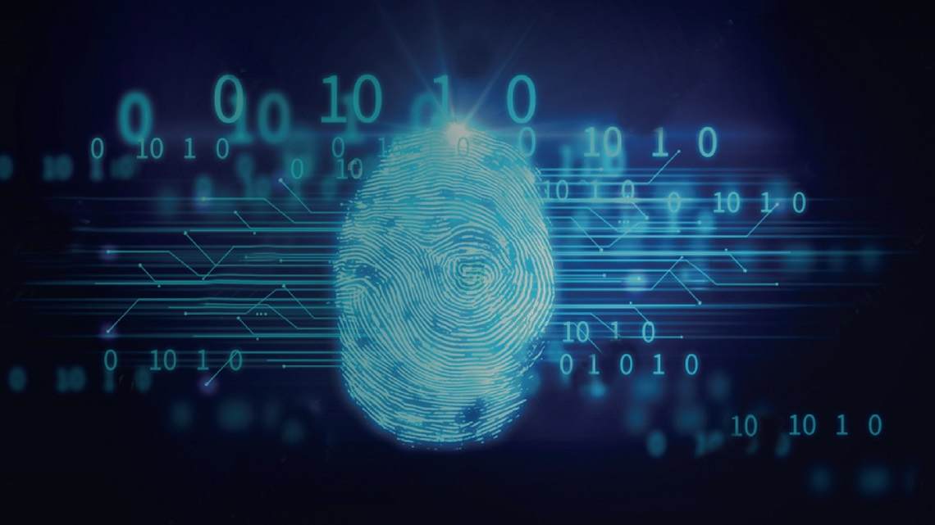
Problem Statement
Consider a scenario where we need to test the authenticity of a document written by an individual.
Our goal is to use fingerprint and signature as metrics for validation. The fingerprint and signature of the user are obtained and the images are cross-verified with existing model to verify them.
The results which fall within our threshold are deemed authentic and those with similarity out of range of our threshold are deemed forged.

Slide 3
Model Building
The model will be trained with datasets of fingerprint and signature.
Image processing and machine learning techniques are used to extract and process these data to tune our model.
After completion of the model, it will be tested to verify our results.

Slide 4
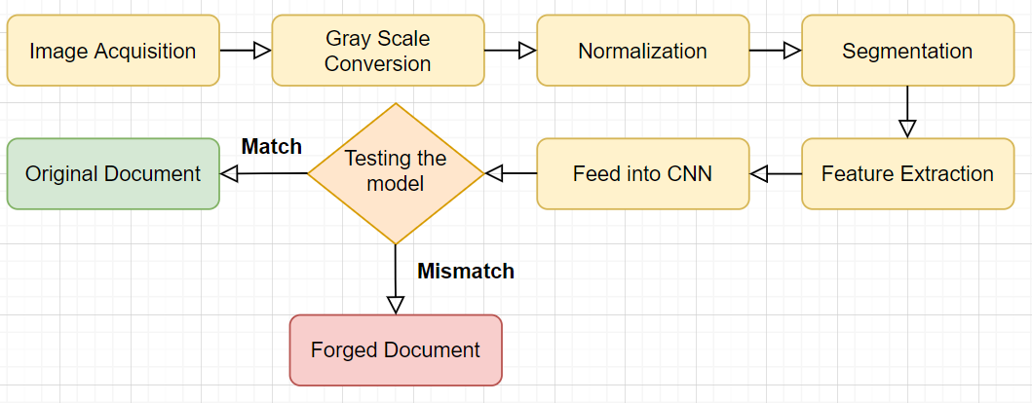
General Procedure

Slide 5
Datasets Used
Fingerprint dataset link:
https://www.kaggle.com/ruizgara/socofing/download
Source: Cornell University
Signature dataset link:
https://www.kaggle.com/robinreni/signature-verification-dataset/download
Source: ICDAR 2011 Signature Dataset

Slide 6
Tools and software required
Python
Pandas
NumPy
OpenCV
PyTorch
TensorFlow
Visual Studio Code
Jupyter Notebook

